Slide 1
Python Semester Project
Real-Time Data Plotter
Senna Smoak

Slide 2
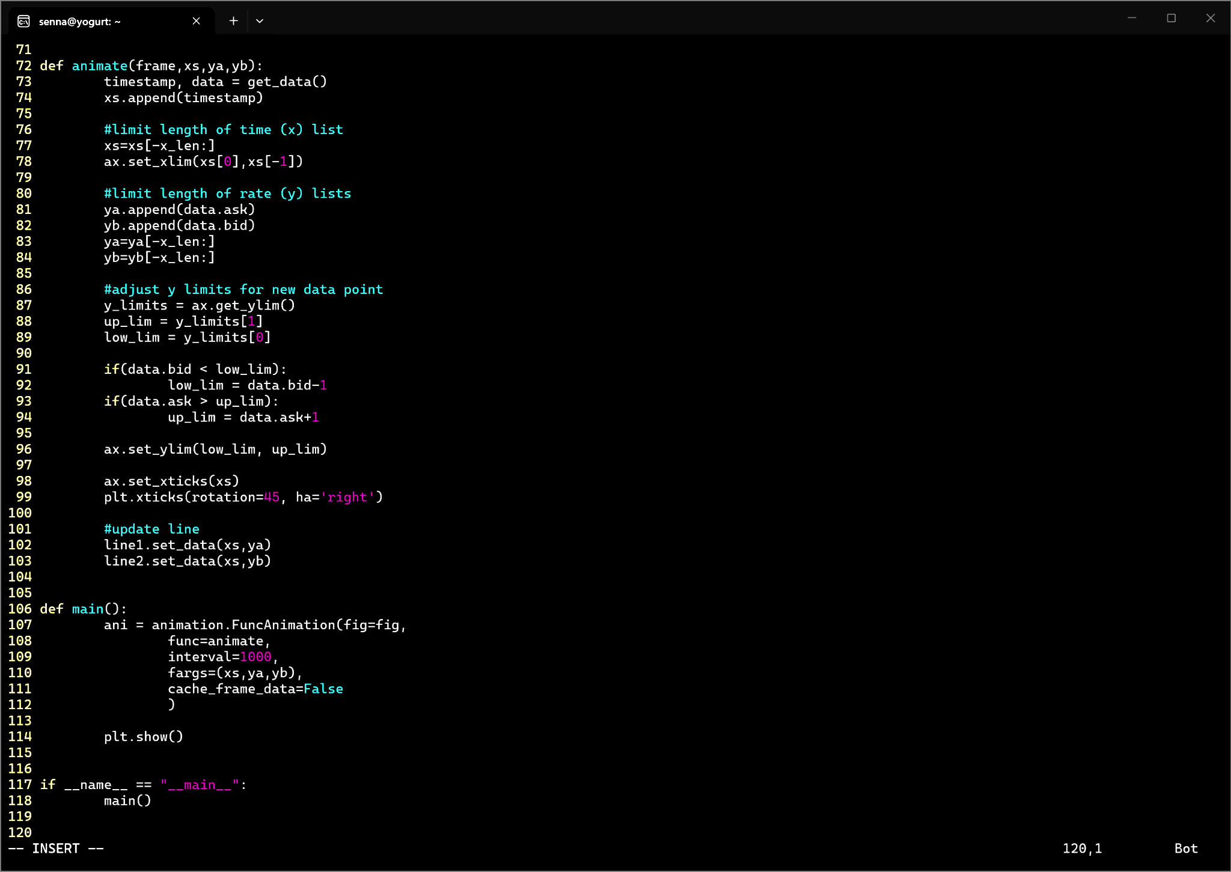
Animated Line Plot
Constructed and animated figure using the matplotlib package, pyplot and animation modules.

Slide 3
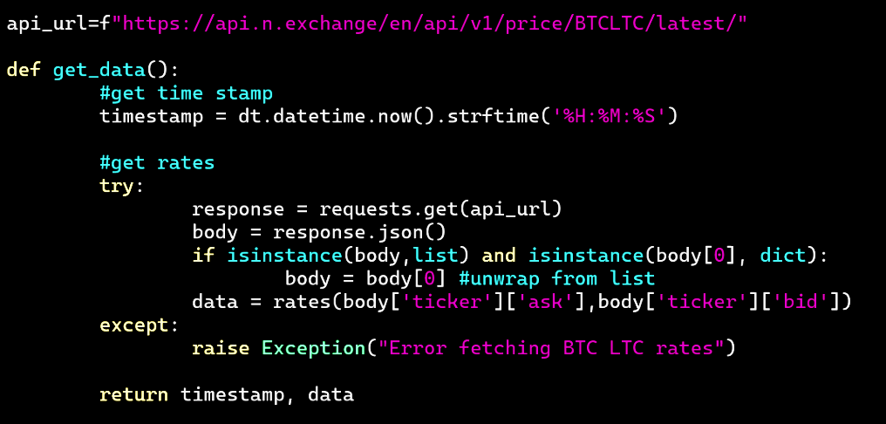
Real-Time Data
Pulled latest price data from n.exchange for bitcoin to litecoin rates.
ex_response = [
{
"created_on": "2026-05-04T01:29:42.558250Z",
"unix_time": "1777858182.0",
"expiration_time_unix": "1777858213.0",
"ticker": {
"ask": "1426.53352354",
"bid": "1424.50142450"
},
"market": {
"name": "n.exchange",
"code": "nex"
},
"rate": "1425.51747401961382",
"allowed_historic_price_variance": true,
"allowed_historic_price_age": true
}
]
Extracted the bidding and asking prices for plotting.
Referenced Worksheet 12 for exception handling.

